Slide 1
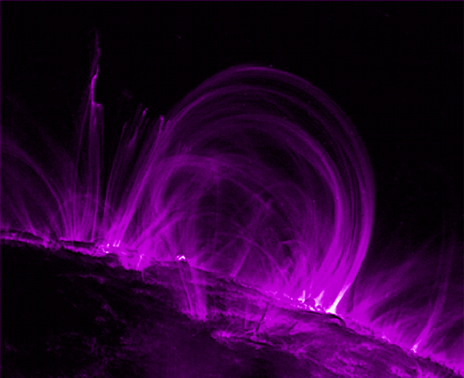
Magnetism and Conductors

Slide 2
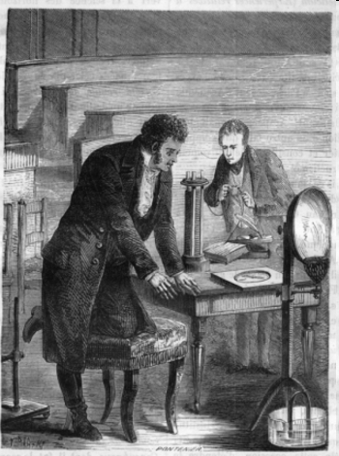
The Connection between Electricity and Magnetism
In 1819,the Danish physicist Hans Christian Oersted (1777–1851) discovered the connection between electricity and magnetism by accident while lecturing on electric circuits at the University of
Copenhagen.

Slide 3
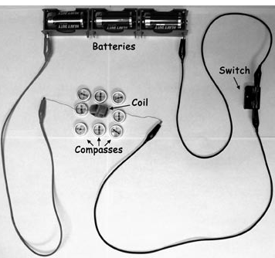
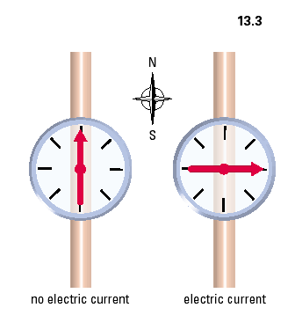
Oersted’s Discovery
Whenever an electric
current moves
through a conductor
(wires), a magnetic field
is created in the region
around the conductor.

Slide 4
Oersted’s Principle (Conductor)
Whenever an electric
current moves
through a conductor
(wires), a magnetic field
is created in the region
around the conductor.

Slide 5
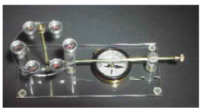
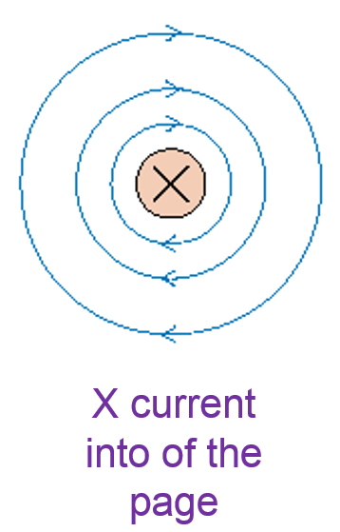
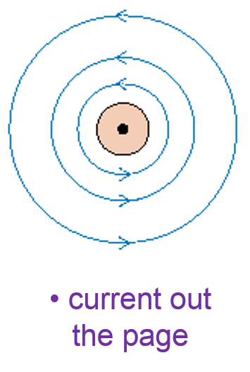
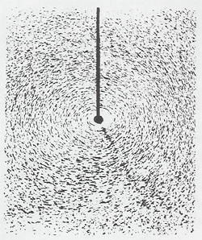
Field Around a Straight Conductor
The direction of the magnetic field is related to
the direction of current through the conductor.

Slide 6
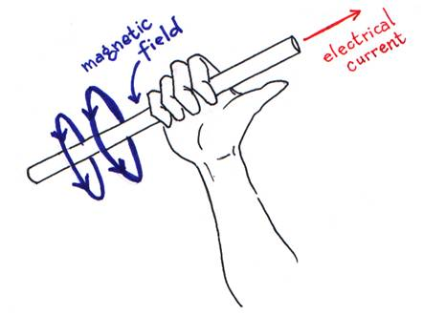
Electric Field Around a Straight Conductor
The shape of the magnetic field around a long, straight wire carrying electric current

Slide 7
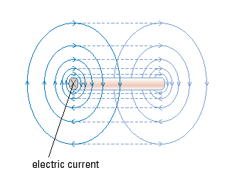
Magnetic Field is 3-Dimensional

Slide 8
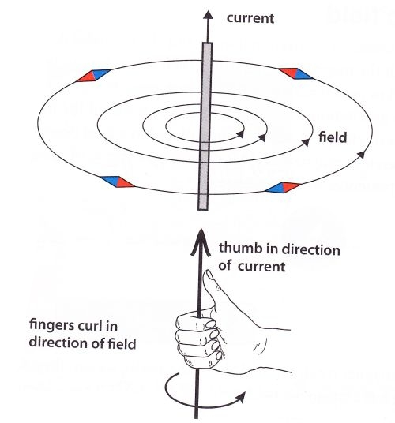
Right Hand Rule #1
Conventional current
Current passing through
a straight wire produces
a circular magnetic field.
The direction of the
field depends on the
direction of the current.
The direction can be
determined using the
“Right Hand Rule #1”
Thumb points in direction of current
Fingers curl in
direction of
field

Slide 9
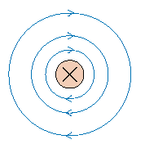
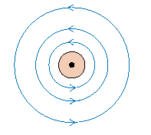
2-D Representation
X current into of the page
current out the page

Slide 10
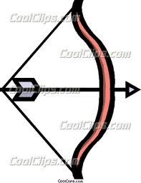
Conventions for 3D
Think about an arrow in the direction
of current.
  The wire is perpendicular to
  the screen
Current going into screen
  We see the tail feathers of
  the arrow
Current coming out of the screen
  We see the point of the arrow
  coming at us (duck!)
X
wire

Slide 11
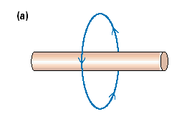
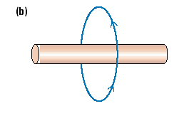
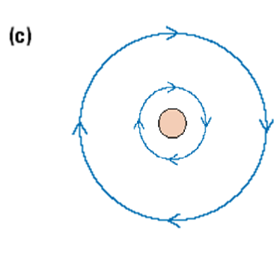
Let’s Try! Find the direction of the conventional current in each wire below.
Conventional Current flows to the right
Conventional Current flows to the left
X
Conventional Current flows into the page!

Slide 12
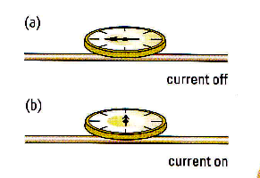
Parallel Wires & Right Hand Rule
Current in a wire creates a
magnetic field
I = 0
Will These Wires
Attract or Repel?
I →
← I

Slide 13
Parallel Wires & Right Hand Rule
Current in a wire creates a
magnetic field
B = 0
I = 0
Determine the direction of
the magnetic field (B).
I →
B
B
← I

Slide 14
Parallel Wires & Right Hand Rule
Current in a wire creates a
magnetic field
Magnetic field (B) points
towards the South Pole!
N
I →
S
B
S
B
← I
N

Slide 15
Parallel Wires & Right Hand Rule
Current in a wire creates a
magnetic field
How About These Wires?
← I
← I

Slide 16


Slide 17
On-line Help
YouTube
  Search “Right Hand Rule”
  http://www.youtube.com/watch?v=jCcUochTbVo
Java Applets
  Search “PhET”
  Search “Right Hand Rule”

Slide 18
Conventions of Current
Note: You Must Remember This
  Current was determined to be the direction of flow from positive to negative
  This is opposite the direction of flow of electrons
  Conventions for current was established before electrons were discovered.
Current Flow
+ve
-ve
Electron Flow

Slide 19
Questions
Using the Right Hand Rule:
Determine if two parallel wires will attract or repel if the current flows in the same direction in both wires. (Draw a diagram of the magnetic fields)
Determine if two parallel wires will attract or repel if the current flows in opposite directions in the wires. (Draw a diagram of the magnetic fields)

Slide 20
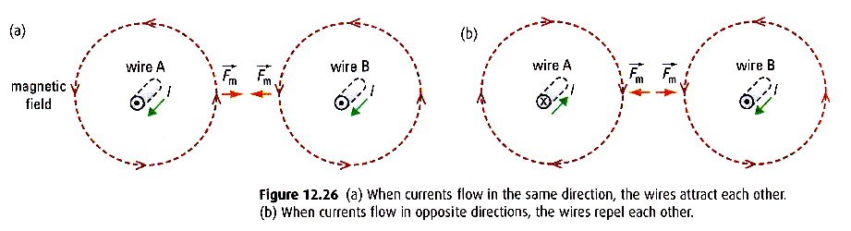
Magnetism and Wires
In the 1820’s the link between magnetism and electric current began to be understood.
Two important observations were made:
  A wire carrying a current can deflect a compass
  needle.
  Two parallel wires affect each other
    They attract if the current is in the same direction
    They repel If the current is in the opposite direction
Predict what a magnetic field around a wire might look like. (Draw a force field diagram and provide a supporting hypothesis.)

Slide 21
Questions
If a current carrying wire is bent into a loop, why is the magnetic field stronger inside the loop than outside?
Determine if the top wire will experience a magnetic force.
I₁
I₂

Slide 22
N
N
S
N
S
N
N
S
S

Slide 23
N
S
X
●
No
Current
Current
up
Current
Down

